Slide 1
LINEAR REGRESSION
Python workshop
Savvas christoforidis
Stavros portokalidis
APOSTOLOS MOUSTAKLIS

Slide 2
Scikit-learn
Scikit-learn is a free software machine learning library
It features various classification , regression and clustering algorithms including SVM , random forest , gradient boosting , k-means etc.
Library files can be downloaded from :
>>> conda install scikit-learn or
>>> pip install –U scikit-learn

Slide 3
Libraries
from sklearn.model_selection import train_test_split(x,y,test_size=0.25)
x is the dependent variables
y is the independent variable
test_size defines the testing data and the training data ratio

Slide 4
Libraries
sklearn.linear_model module implements generalized linear models such as Ridge, Bayesian, Lasso regression models
We will need also the mean_squared_error function provided by the sklearn_metrics module in order to calculate the error of the linear model

Slide 5
Linear model
>>> lr_model = linear_model.LinearRegression( )
returns a linear model using the least squares function
>>> lr_model.fit(X , y)
fits linear model where X the matrix/array of the training data and y the array of the target data
>>> lr_predict(X)
returns predicted values of the matrix/array X using the linear model

Slide 6
Linear model
>>> lr_model.score(X_test, y_test)
returns the coefficient of determination R^2 of the prediction where the best possible score is 1
>>> lr_model.coef_
returns an array of all dependent data coefficients
>>> lr_model.intercept_
returns the independent term in the linear model

Slide 7
Ridge REGULARIZATION
>>> ridge = linear_model.Ridge(alpha=1.0)
where alpha is the regularization strength which improves the conditioning of the problem and reduces the variance of the estimates
>>> ridge.fit(X, y)
>>> ridge.predict(X)

Slide 8
Ridge REGULARIZATION
>>> ridge.score(X_test, y_test)
>>> ridge.coeff_
>>> ridge.intercept_

Slide 9
LASSO REGULARIZATION
>>> lasso = linear_model.Lasso(alpha=0.1)
where alpha is the constant which multiplies the L1 term. Using alpha=0 with the Lasso object is equivalent with an ordinary least square and is not advised
>>> lasso.fit(X, y)
>>> lasso.predict(X)

Slide 10
LASSO REGULARIZATION
>>> lasso.score(X_test, y_test)
>>> lasso.coeff_
>>> lasso.intercept_

Slide 11
LEAST SQUARES ERROR
For the calculation of the error we will use the following code :
>>> mse = mean_squared_error(y_test, y_pred)
>>> rmse = math.sqrt(mse)
where sqrt the square root library y_test the actual y values and y_pred the predicted y values generated from the linear model

Slide 12
TASK
Create the linear model for the following dataset and regularize it using L1(Ridge) and L2(Lasso).
Calculate RMSE and scores for each model
Visualise the given data and the linear models

Slide 13
implementation
Importing Libraries
We will need pandas , math and matplotlib.pyplot and the already mentioned modules of the sklearn
>>> from sklearn.model_selection import train_test_split
>>> from sklearn import linear_model
>>> from sklearn.metrics import mean_squared_error

Slide 14
IMPLEMENTATION
Import data using pandas
>>> pd.read_csv(‘Salary_Data.csv’)
>>> df.info( )
>>> df.head( )
>>> x=df[['YearsExperience’]]
>>> y=df[['Salary’]]
>>> plt.scatter(x,y)

Slide 15
IMPLEMENTATION
Spliting data
>>> x_train , x_test , y_train , y_test = train_test_split(x,y,test_size=0.25)
Least squares model
>>> lr_model = linear_model.LinearRegression()
>>> lr_model.fit(x_train, y_train)
>>> print('LINEAR MODEL')
>>> print('y = ' , float(lr_model.coef_[0]) , ' * x + ' , float(lr_model.intercept_))
>>> print('Training score: {}'.format(lr_model.score(x_train, y_train)))
>>> print('Test score: {}'.format(lr_model.score(x_test, y_test)))
>>> y_pred = lr_model.predict(x_test)

Slide 16
IMPLEMENTATION
Least squares error
>>> mse = mean_squared_error(y_test, y_pred)
>>> rmse = math.sqrt(mse)
>>> print('RMSE: {}'.format(rmse))

Slide 17
IMPLEMENTATION
Visualise results
>>> plt.scatter(x_test,y_test)
>>> plt.plot(x_test,y_pred)

Slide 18
IMPLEMENTATION
Ridge model (L2 Regularization)
>>> ridge = linear_model.Ridge(alpha=1.0)
>>> ridge.fit(x_train, y_train)
>>> print('RIDGE MODEL')
>>> print('y = ' , float(ridge.coef_[0]) , ' * x + ' , float(ridge.intercept_))
>>> print('Training Score: {}'.format(ridge.score(x_train, y_train)))
>>> print('Test Score: {}'.format(ridge.score(x_test, y_test)))
>>> y_ridge_pred = ridge.predict(x_test)

Slide 19
implementation
Lasso model (L1 Regularization)
>>> lasso = linear_model.Lasso(alpha=0.01)
>>> lasso.fit(x_train, y_train)
>>> print('LASSO MODEL’)
>>> print('y = ' , float(lasso.coef_[0]) , ' * x + ' , float(lasso.intercept_))
>>> print('Training Score: {}'.format(lasso.score(x_train, y_train)))
>>> print('Test Score: {}'.format(lasso.score(x_test, y_test)))
>>> y_lasso_pred = lasso.predict(x_test)

Slide 20
IMPLEMENTATION
Final plotting of all models
>>> plt.scatter(x_test,y_test)
>>> plt.plot(x_test,y_pred)
>>> plt.plot(x_test,y_ridge_pred,color='black’)
>>> plt.plot(x_test, y_lasso_pred, color='red’)
>>>plt.show()

Slide 21
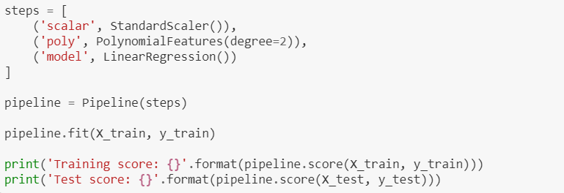
Alternative way

